Slide 1









Whiteboardmaths.com
7
2
1
5
© 2004 All rights reserved

Slide 2
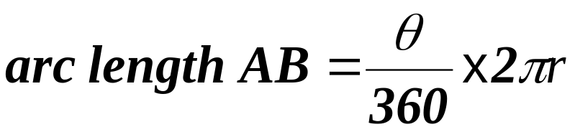
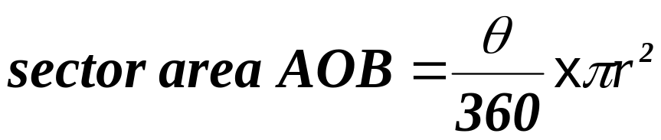
ARCS and SECTORS of CIRCLES
The angle θ between two radii of a circle divides the circle into a minor and a major sector. The arc lengths of each sector are the minor and major arcs respectively.
Major Arc
Major Sector
O
θ
A
B
Minor Sector
Minor Arc

Slide 3
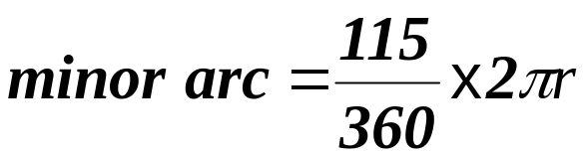
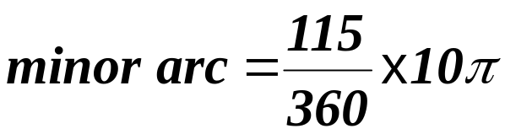

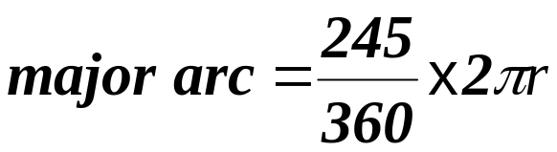
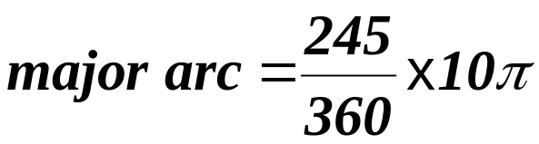

Calculating arc lengths of Circles
Example 1: Calculate the lengths of the minor and major arcs AB for the circle shown.
O
5 cm
115º
A
B

Slide 4



Calculate the lengths of the minor and major arcs in each case (to 1 dp)
1
2
3
O
O
O
2.3 cm
9 cm
3 cm
75º
155º
88º
Minor arc = 11.8 cm
Minor arc = 8.1 cm
Minor arc = 3.5 cm
Major arc = 44.8 cm
Major arc = 10.7 cm
Major arc = 10.9 cm
4
5
6
2.4 m
O
O
130º
1.3 m
215º
312º
7 cm
Minor arc = 15.9 cm
Minor arc = 3.3 m
Minor arc = 2.0 m
Major arc = 28.1 cm
Major arc = 4.9 m
Major arc = 13.1 m

Slide 5
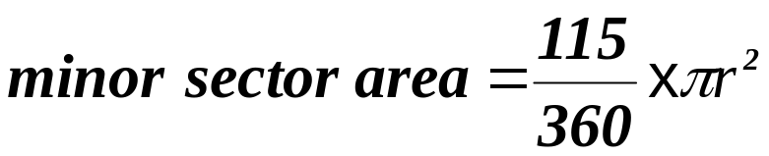
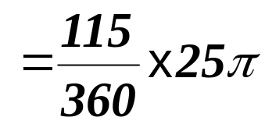

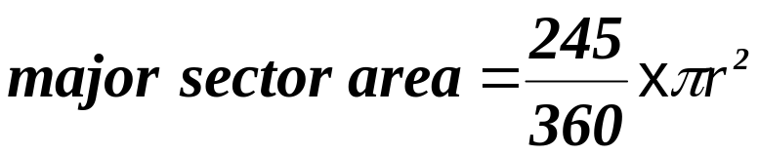
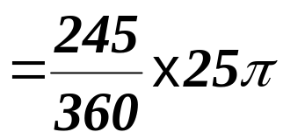

Calculating sector areas of Circles
Example 1: Calculate the areas of the minor and major sectors for the circle shown.
O
5 cm
115º
A
B

Slide 6
Calculate the minor and major sector areas in each case (to 1 dp)
1
2
3
O
O
O
2.3 cm
9 cm
3 cm
75º
155º
88º
Minor sector = 53.0 cm²
Minor sector = 12.2 cm²
Minor sector = 4.1 cm²
Major sector = 201.5 cm²
Major sector = 16.1 cm²
Major sector = 12.6 cm²
4
5
6
2.4 m
O
O
130º
1.3 m
215º
312º
7 cm
Minor sector = 55.6 cm²
Minor sector = 2.1 m²
Minor sector = 2.4 m²
Major sector = 98.3 cm²
Major sector = 3.2 m²
Major sector = 15.7 m²

Slide 7
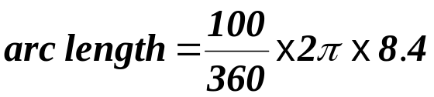



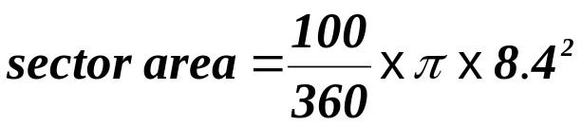



Example Question: The shape below is a sector of a circle of radius 8.4 cm. Find (a) the arc length and (b) sector area.
Now try this one.
100º
8.4 cm
3 .1 m
160º

Slide 8
Worksheets
Calculate the lengths of the minor and major arcs in each case (to 1 dp)
1
2
3
O
O
O
2.3 cm
9 cm
3 cm
75º
155º
88º
4
5
6
2.4 m
O
O
130º
1.3 m
215º
312º
7 cm

Slide 9
Calculate the minor and major sector areas in each case (to 1 dp)
1
2
3
O
O
O
2.3 cm
9 cm
3 cm
75º
155º
88º
4
5
6
2.4 m
O
O
130º
1.3 m
215º
312º
7 cm

Slide 10
Example Question: The shape below is a sector of a circle of radius 8.4 cm. Find (a) the arc length and (b) sector area.
Now try this one.
100º
8.4 cm
3 .1 m
160º

